Slide 1

Impact of Covid-19 in Economics books selled by Amazon.co.uk (Oct.2019 vs. Oct.2020)
Project 5
Marisa Fernandes

Slide 2


Should a Publisher make changes in economic book’s market, due to Covid-19?

Slide 3
Topic and core questions
Topic of interest: books
Subject: Business, Finance and Law – specifically Economics
Where: Amazon.co.uk
Time: October 2019 and October 2020 as publication date
Questions for Statistical hypothesis testing
Has Covid-19 Pandemic influence in the subject of economics books published?
And in the number of pages?
And in the price of books?

Slide 4
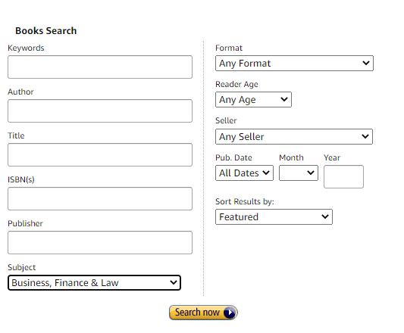

Amazon.co.uk: Let’s collect data

Slide 5
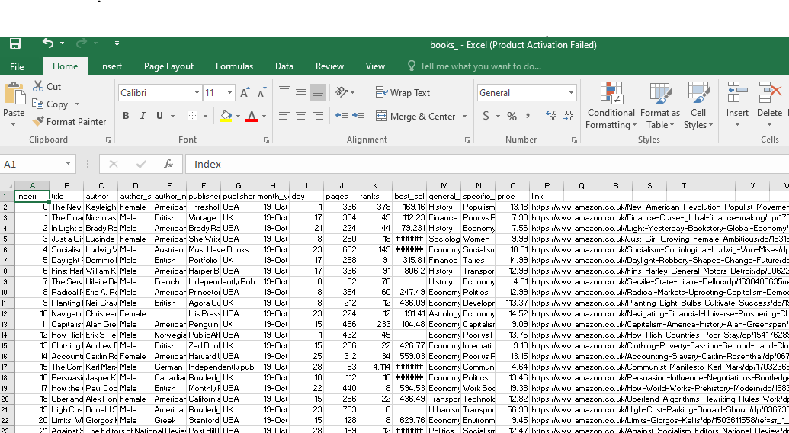

Excel: Create table and csv file

Slide 6
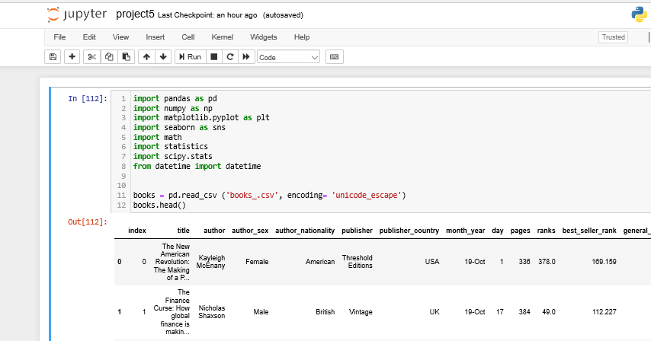

Python: let’s do Statistical hypothesis testing

Slide 7
Hypothesis testing
scipy.stats.ttest_ind (for pages)
st.ttest_ind(books_19['pages'], books_20['pages'])
pvalue=0.9950688391916672
H0: the number of pages from the different books is equal to the number of pages between October 2019 and October 2020

Slide 8

Hypothesis testing
scipy.stats.ttest_rel
st.ttest_ind(books_19['price'], books_20['price'])
pvalue=0.6301918971332217
H0: the price from the different books is equal to the price between October 2019 and October 2020

Slide 9

Hypothesis testing
scipy.stats.chi2_contingency
st.chi2_contingency(np.array(evolution_table))
pvalue= 0.3089623054808429
The subject are independent of the "before covid-19" and "after covid-19"

Slide 10


Conclusions
It seems to be a bad idea making changes in the economic books’market, due to Covid-19…

Slide 11
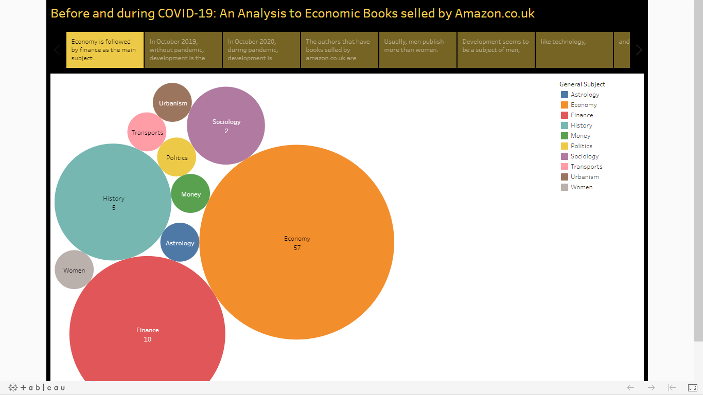

And before finishing… Tableau: Let’s show some data analysis

Slide 12
Next Steps
More data from Amazon.co.uk
Do this for Amazon.de, Amazon.fr, Amazon.it, Amazon.es, Leya.com.pt/bertrand.pt (in order to understand the European market)

Slide 13
Thank you!

